Slide 1
Academics Office Update
February 11, 2025
Dr. Allison Deno, Chief of Schools

Slide 2
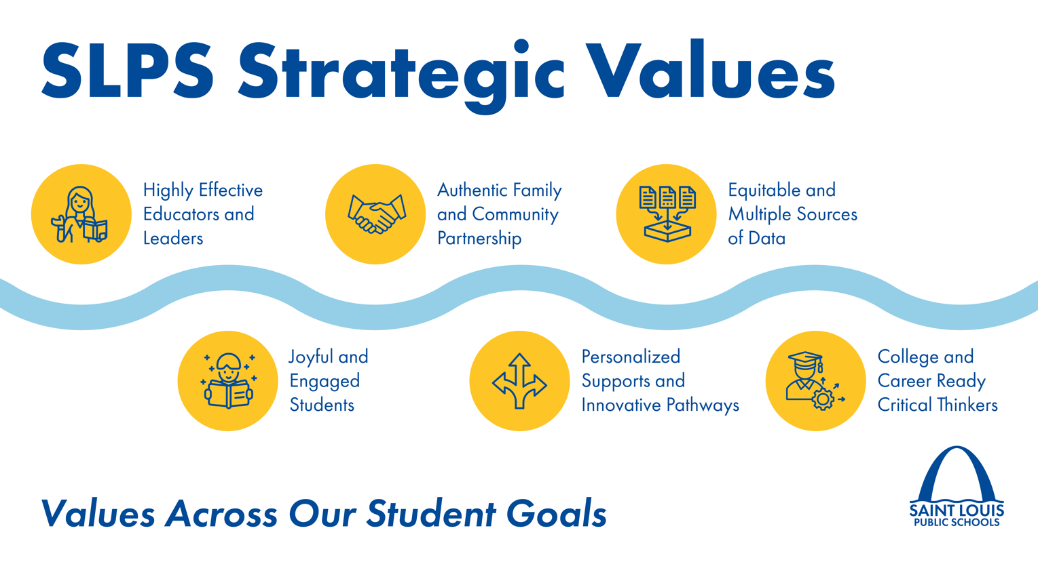


Slide 3
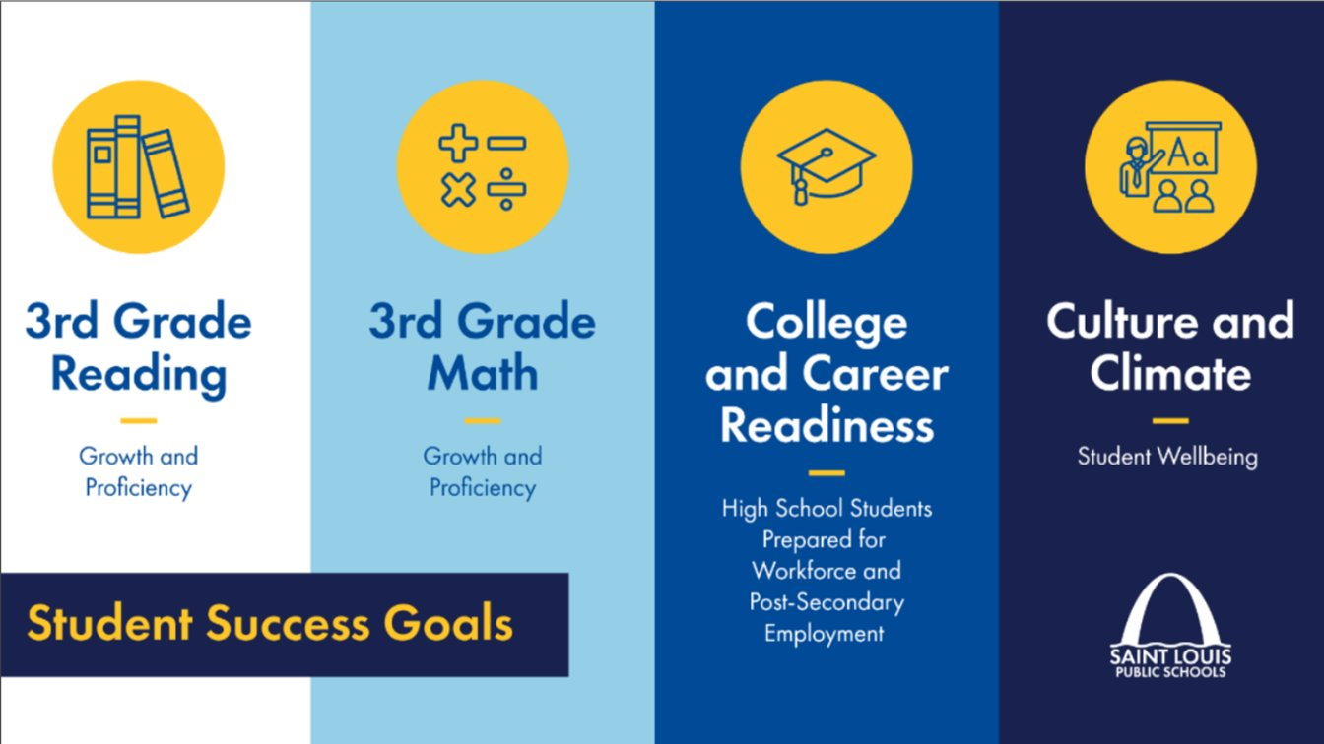

Slide 4
Portrait of a Graduate
College & Career Ready
Change Agent
Communicator
Competent
Culturally Aware
Collaborator
Critical Thinker

Slide 5
Agenda
Transformation Plan 4.0 - Pillar 1 Evidence
Transformation Plan 4.0 - Pillar 2 Evidence

Slide 6
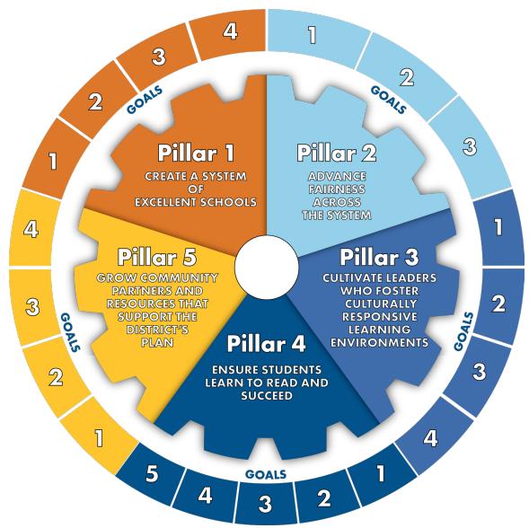
Continuous School Improvement Plan (CSIP)

Slide 7
Pillar 1 – Create a system of excellent schools.
Goals
Goal 1: By 2024-25; SLPS will reinforce advanced accreditation goals. All schools will earn a minimum of 70% in MSIP VI Annual Performance Report metrics.
As of the 2024-2025 school year 5 schools in SLPS have met this goal and earned at least 70% on their 2024 MSIP VI Annual Performance Report.

Slide 8
Pillar 1 – Create a system of excellent schools.
Goals
Goal 2: By 2023-2024 SLPS will maintain a minimum 30% unrestricted fund balance per Board policy allowing more funds for strategic initiatives.
The district's projected unrestricted fund balance for fiscal year 2023-2024 is $231,749,325*, reflecting 54.36%. This amount exceeds the mandated minimum of 30% and provides flexibility for implementing strategic initiatives aimed at enhancing the district's operations and educational programs. *The Fund balance is subject to change based on the annual finalized audit.

Slide 9
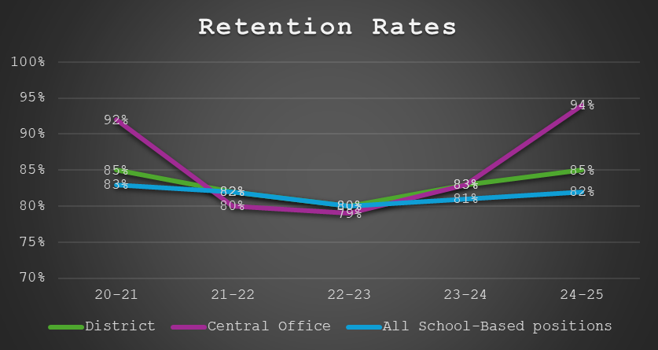
Pillar 1 – Create a system of excellent schools.
Goals
Goal 3: By the end of the 2022-2023 school year innovative staffing and recruitment practices will have increased retention rates by 5% across all job types (1-3 years from hire date) and 90% of all vacancies will be filled at the start of each semester.

Slide 10
Pillar 1 – Create a system of excellent schools.
Goals
Goal 4: By 2023-2024, all 71 Saint Louis Public School buildings will be in compliance with an Energy STAR score of 75 or higher.
As of the 2023-2024 school year 13 schools in SLPS have met this goal and are in compliance with an Energy STAR score of 75 or higher. Froebel – 75 Energy STAR score Innovation Concept Academy @ Blewett – 77 Energy STAR score Roosevelt High School – 78 Energy STAR score Gateway STEM – 83 Energy STAR score Walbridge – 84 Energy STAR score Lyon @ Blow – 87 Energy STAR score Soldan – 88 Energy STAR score Ford – 92 Energy STAR score St. Louis Adult Learning Center – 97 Energy STAR score Fanning – 97 Energy STAR score Farragut – 99 Energy STAR score Northwest – 99 Energy STAR score Dunbar – 99 Energy STAR score

Slide 11
Pillar 2 – Advance fairness across the system.
Goals
Goal 1: By May 2023, SLPS schools will remove barriers and help all students access academic enrichment experiences such as field trips, enrichment programs and elective courses by 10% as evidenced by two-year comparison data.
# of AP courses offered 126 (23-24) % of students of color in the Gifted program 26% Black <1 % Asian Indian 5% Asian 4% Hispanic 7% Multi- racial % of chronic absenteeism among k-12 students - 51.1%

Slide 12
Pillar 2 – Advance fairness across the system.
Goals
Goal 2: By the end of the 2022-2023 school year, SLPS will provide access to medical care for all students through telehealth medical services.
# of students accessing telehealth services: 0 # of nurses and medical designees trained: 27 % of students meeting 90/90: AY 2023: 48.16 % AY 2024: 47.52 % AY 2025: 48.87 %
Notes:
Staff were trained in Hazel Health – no students or parents have accessed this so far.

Slide 13
Pillar 2 – Advance fairness across the system.
Goals
Goal 3: By the end of the 2022-2023 school year, SLPS will have increased the number of mental health partners and breadth of services and students, and staff will be more aware of supports available to them inside and outside of school.
Increase of (K-12) providers of mental health support; SY 24-25 5 external partners; 5 internal therapists provided through grant funding. % increase (K-12) mental self-awareness through a social emotional learning curriculum platform; SY 23-24: 198 students participated in focus groups related to self-awareness; SY 24-25 all SLPS students receive Re-Think Ed lessons on social emotional learning from school counselors and classroom teachers. # of students and families engaged through mental health campaigns; SY 23-24 154 participants; SY 24-25 51 participants.

